Slide 1
ALGEBRA 4
Day 57

Slide 2
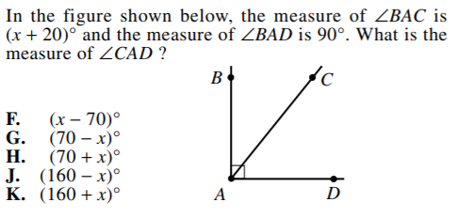
Bell Work

Slide 3
For Next Time
page 700 #1-5, 9-17 (odd)

Slide 4
11.4 Conditional Probability
Objective: To find conditional probabilities

Slide 5
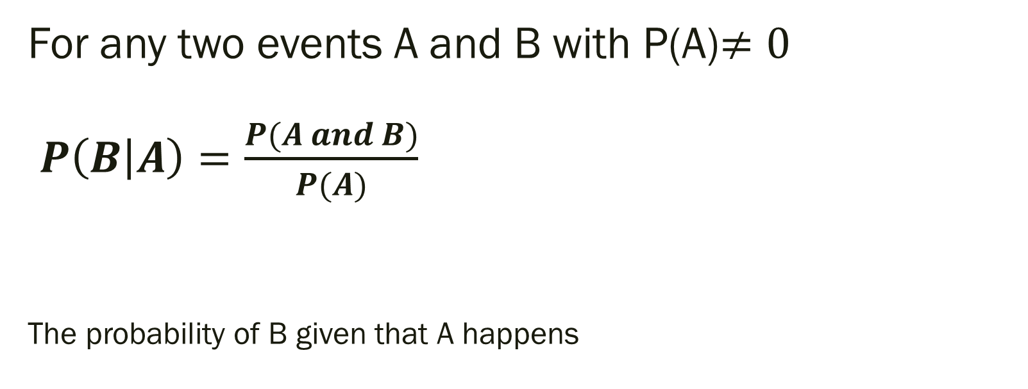
Conditional Probability:
For any two events A and B with P(A)$≠0$ $P\left(B | A\right)=\frac{P(A and B)}{P(A)}$
The probability of B given that A happens

Slide 6
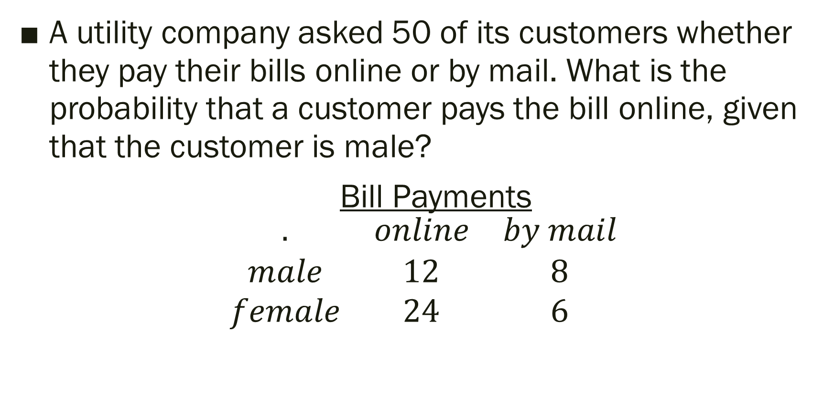
Example
A utility company asked 50 of its customers whether they pay their bills online or by mail. What is the probability that a customer pays the bill online, given that the customer is male?
Bill Payments
$$\begin{matrix}. & online & by mail \\ male & 12 & 8 \\ female & 24 & 6\end{matrix}$$

Slide 7
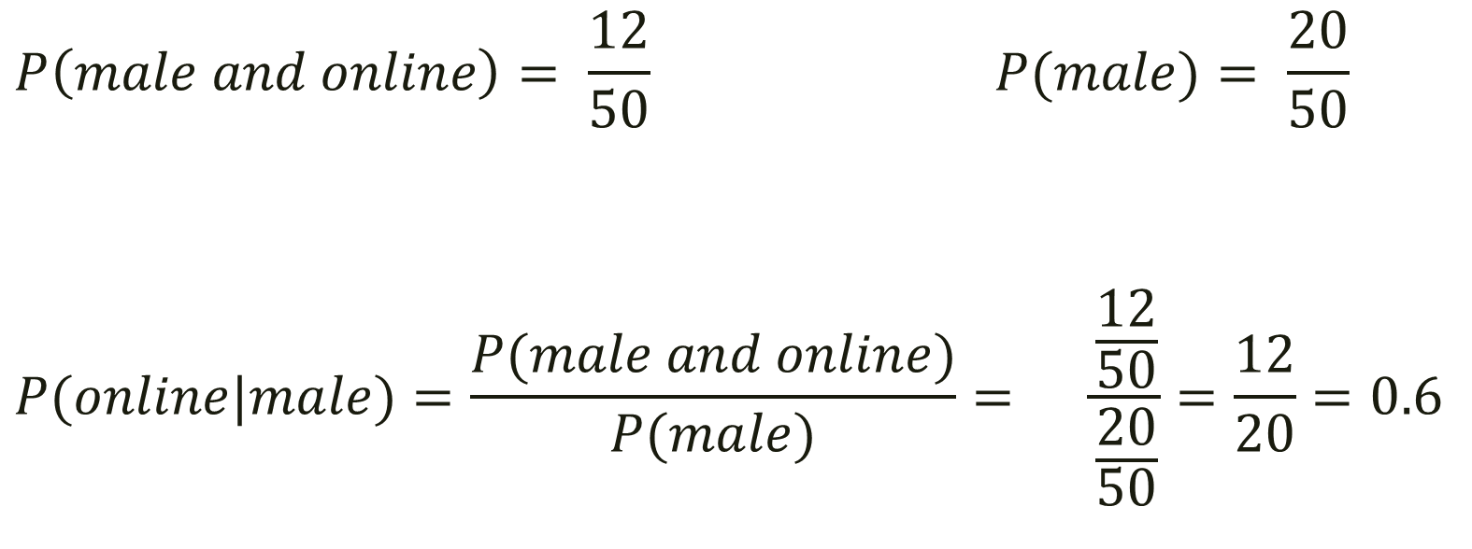
Answer
$$P\left(male and online\right)= \frac{12}{50} P(male)= \frac{20}{50}$$
$$P(online|male)=\frac{P(male and online)}{P(male)}= \frac{\frac{12}{50}}{\frac{20}{50}}=\frac{12}{20}=0.6$$
The probability that a customer pays online given that the customer is male is 60%.

Slide 8
Think deeper…
Could we find the probability of customer paying by mail given that she is a female?
What other scenarios could we attempt to find?

Slide 9
11.5 Probability Models
Objective: To use probabilities to make fair decisions and analyze decisions

Slide 10
In order for a decision to be considered fair the probability of each outcome must be the same.

Slide 11
Are the following situations considered fair? Explain your reasoning?
A teacher wants to pick 2 students at random from the class. The teacher lines them up in order from tallest to shortest and has the first student flip a coin, if they get heads they will be picked, if they get tails they will not. The first two students to flip heads are the two the teacher picks.

Slide 12
Possible Answer
Not fair. The shorter students probably won’t even get a chance to flip the coin because the chances that a taller student flips heads first is greater.

Slide 13
Are the following situations considered fair? Explain your reasoning?
A teacher wants to agrees to roll dice. If it is even there will be no homework, and if it is odd then there will be homework.

Slide 14
Possible Answer
Yes. Both situations have a equal chance of happening.

Slide 15
Probability model
A mathematical representation of a situation in which probabilities are assigned to outcomes.

Slide 16
Example:
McDonalds is giving away toys in happy meals. There are six different toys that will be randomly placed with the meal. Create a simulation that could model the chances of getting each toy.

Slide 17
Possible Solution:
You could assign a number from 1-6 to each toy then roll a die and record the results until you have rolled each number at least once. (I did this for you already just to save time, if you want to do it there is a die in the back left cabinet!)
Results on next slide

Slide 18
I rolled the dice until all options showed up at least once… results below
Roll Frequency:
1: III
2: IIII
3: II
4: I
5: II
6: III
The results of this trial indicate that you would have to buy 3+4+2+1+2+3=15 happy meals in order to get all six different toys.

Slide 19
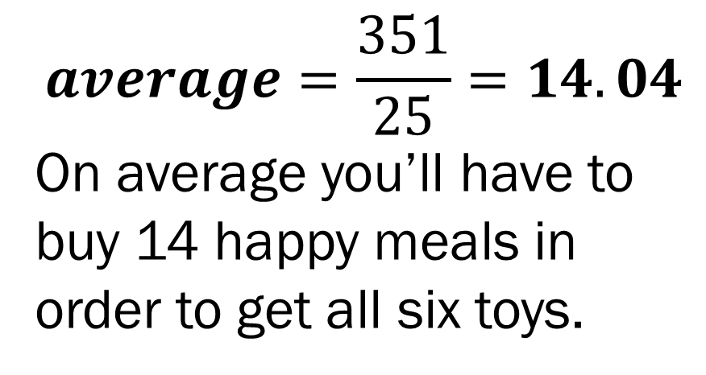
Expand for Accuracy:
Repeat this exact same simulation multiple times. I did 25 and find the average.
15, 17, 10, 8, 18, 22, 10, 12, 14, 13, 11, 18, 19, 18, 10, 11, 11, 18, 19, 20, 11, 12, 10, 9, 15
$$average=\frac{351}{25}=14.04$$
On average you’ll have to buy 14 happy meals in order to get all six toys.

Slide 20
Using Probability to Analyze Decisions
A company is testing the effectiveness of a new drug. 160 volunteers are split into two groups without their knowledge. 80 are given the drug and 80 given a placebo. They are then asked if they noticed an improvement in their symptoms.
The results are in the table on the next slide.

Slide 21

What is the probability that a volunteer received the placebo given that they did not report a noticeable improvement?
$$\begin{matrix} Improved & Didn^{′}t Improve & Total\end{matrix}$$
$$\begin{matrix}Drug & 67 & 13 \\ Placebo & 24 & 56 \\ Total & 91 & 69 \end{matrix}\begin{matrix} 80 \\ 80 \\ 160 \end{matrix}$$

Slide 22
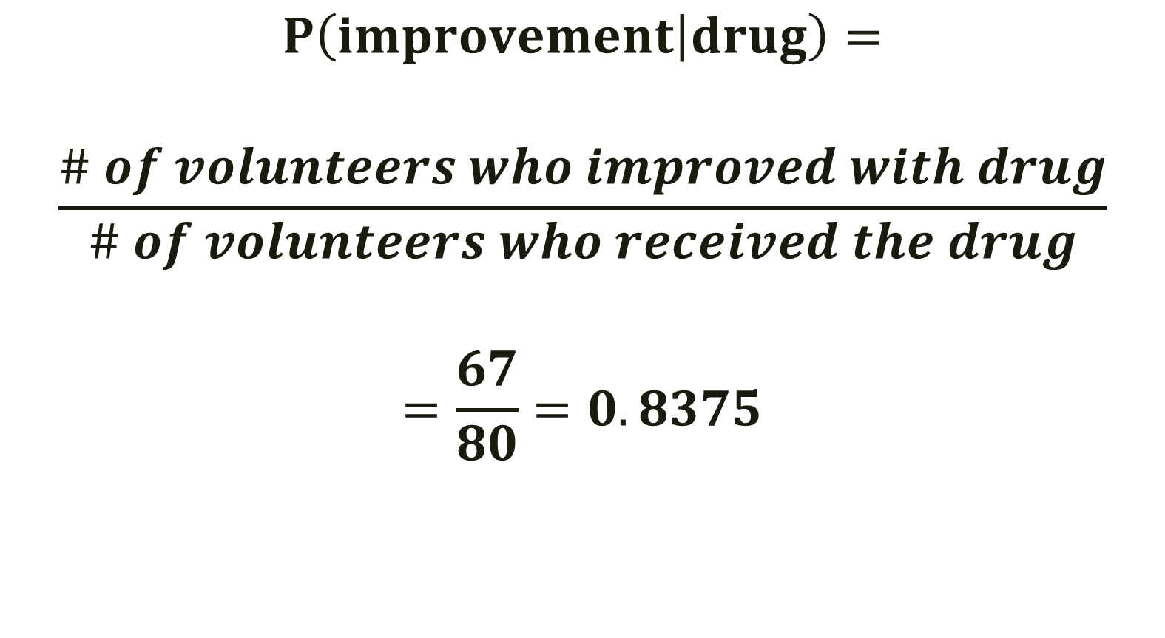
Solution
$$P\left(improvement | drug\right)=$$
$$\frac{\# of volunteers who improved with drug}{\# of volunteers who received the drug}$$
$$=\frac{67}{80}=0.8375$$

Slide 23
What is the probability that a volunteer received the placebo given that they did not report a noticeable improvement?

Slide 24
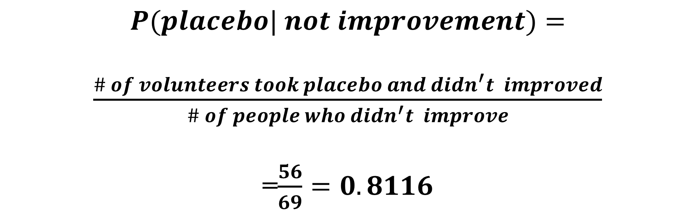
What is the probability that a volunteer received the placebo given that they did not report a noticeable improvement?
$$P(placebo| not improvement)=$$
$\frac{\# of volunteers took placebo and didn^{′}t improved}{\# of people who didn^{′}t improve}$
=$\frac{56}{69}=0.8116$

Slide 25
Should they make/distribute the drug? Justify your answer.

Slide 26
Should they make/distribute the drug? Justify your answer.
Yes, 83% of the people who took it improved and 81% of people who had the placebo didn’t improve.
What would a result look like that would cause them to not want to distribute the drug? Is there more than one situation?

Slide 27
For Next Time
Page 707 #1-9, 11

